Slide 1
Sacraments of Healing: Penance and Anointing of the Sick
Ministry Formation
Diocese of Rockford

Slide 2
Sacraments in General…
“Outward sign, instituted by Christ, to give grace.”
A Visible sign of an invisible reality
All have form and matter
All are scriptural
All are efficacious
Initiation, Healing, Service

Slide 3
Penance

Slide 4
Confession Overview:
Reconciliation, Penance, Confession
Heals the wounds caused by sin
Priests & Bishops are the ministers
“Matter” = sins confessed with contrition
“Form” = Confession/Penance/Absolution
Received multiple times
Scripture passages:
Matthew 16:19 “whatever you bind on earth…”
John 20:22-23 “whosever sins you forgive are forgiven…”
James 5 16 “Confess your sins to one another…”

Slide 5
What happens (or what should happen) in confession?
Sins are forgiven – actually “absolved” – what’s the difference?
Receiving grace and restoration to a state of grace.
There can also be a lifting of penalties…
Spiritual advice/counsel can be given – but it should not be a place for spiritual direction nor socializing…
It is not a forum to confess other people’s sins or have a meeting with Father…

Slide 6
Common Questions about Confession:
Is it the only way to be forgiven?
What about presumption?
What if I don’t remember my penance? Or can’t do it?
What if I forget to confess a sin?
What about the seal of confession?
Can non-Catholics go?
Do I confess my venial sins?
Is it a sin not to go to confession?
What if I overhear someone else’s confession?
Does the priest remember my last confession?
How often should I go?
What if the priest forgets to give me absolution? Or a penance?

Slide 7
The number one question about confession…
Why do Catholics confess to a priest? Why not just confess to God?

Slide 8
The answer to that comes from our understanding of sin…
It affects three relationships: with God, with others (the Body of Christ), with ourselves…
Remember that sin has certain effects – venial sin weakens, mortal sin breaks…
It is in confessing a sin to a priest (specifically a mortal sin) that all three of those relationships can be brought to bear and be healed.

Slide 9
A brief look at the history of confessing sins…
It has Jewish roots – we see this both in the practices before Jesus and during His ministry.
But with Jesus we have a new take on it – it is no longer about making sacrifices of animals, etc.
Jesus not only forgives sins but gives the Apostles the authority to do the same – it is His power, His authority that He entrusts to them.

Slide 10
We know that confession of sins was a part of early Christianity – both in Apostolic times and post-Apostolic.
It took different forms, and was debated – but has always existed
Letter of Barnabas (74 AD): “You shall confess your sins.”
Ignatius of Antioch (110 AD): “And as many as shall, in the exercise of penance, return into unity of the Church…”
Tertullian (203 AD): “The Church has the power of forgiving sins…”
“A second plank thrown out after a shipwreck…”
Hippolytus (215 AD): “…and by the Spirit of the high priesthood to have the authority to forgive sins, in accord with your command.”

Slide 11
Early on – and for a long time – public confession existed.
By the 3rd century, Irish/Celtic monks would hear individual confessions privately and assign a penance… this was a part of Celtic spirituality for a long time (i.e. confessing to an “anam cara” – soul friend)
Around the 7th century these practices began to be brought more into European practice.
With the Council of Trent we have the final stamp of approval for the understanding and practice of Reconciliation that we have today.
After Vatican II we have more of a focus on God’s Love and Mercy, rather than on His judgment.

Slide 12
Let’s look at the practice of this Sacrament a little closer…
Rite of Reconciliation of Individual Penitents
The penitent should prepare for the celebration of the sacrament by prayer, reading of scripture and silent reflection.
Close door after entering. You may kneel behind the screen and remain anonymous or sit in the chair and confess face to face.
RECEPTION OF THE PENITENT
GREETING
When the penitent comes to confess his sins, the priest welcomes him warmly and greets him with kindness.
SIGN OF THE CROSS
The Penitent makes the Sign of the Cross:
In the name of the Father, and of the Son, and of the Holy Spirit. Amen.

Slide 13
INVITATION TO TRUST IN GOD
The priest invites the penitent to have trust in God.
READING OF THE WORD OF GOD
The priest may read or say from memory a text of Scripture which proclaims God’s mercy and calls man to conversion.
CONFESSION OF SINS AND ACCEPTANCE OF SATISFACTION
The penitent begins:
It has been ___ since my last confession. My sins are....
The penitent concludes :
These are all my sins.
The priest gives the penitent counsel and proposes an act of penance which the penitent accepts to make satisfaction for sin and to amend his life. The penitent should ask any appropriate questions.

Slide 14
PRAYER OF THE PENITENT AND ABSOLUTION
The priest then asks the penitent to express his sorrow, which the penitent may do in these or similar words:
My God, I am sorry for my sins with all my heart. In choosing to do wrong and failing to do good, I have sinned against you, whom I should love above all things. I firmly intend, with your help, to do penance, to sin no more, and to avoid whatever leads me to sin. Our savior Jesus Christ suffered and died for us. In his name, my God, have mercy.
or
Wash me from my guilt and cleanse me of my sin. I acknowledge my offense; my sin is before me always. Psalm 51:4-5
or
Father, I have sinned against you and am not worthy to be called your son. Be merciful to me, a sinner. Luke 15:18, 18:13

Slide 15
The priest then extends his hand over the penitent’s head and says the prayer of absolution. The penitent answers:
Amen. PROCLAMATION OF PRAISE OF GOD AND DISMISSAL
After the absolution, the priest continues:
Give thanks to the Lord, for he is good. –Psalm 118:1
The penitent concludes: His mercy endures for ever. The priest dismisses the penitent who has been reconciled.

Slide 16
A few things to keep in mind regarding confession…
Presumption…
What should be done about remembering past sins (especially if we don’t know if we confessed them or not)?
Scrupulosity…
General Absolution
Contrition…

Slide 17
Good preparation makes for a good confession.
Writing things down is ok…
Going more often helps you get better at going.

Slide 18
Final thoughts or questions?

Slide 19
Anointing of the Sick

Slide 20
Anointing overview:
Last Rites, Extreme Unction, Anointing of the Sick
Heals body and/or soul
Offers spiritual (physical) strength, protection
Can be combined with other Sacraments
Performed by bishop or priest (not deacons**)
Received multiple times
Matter: oil of the sick
Form: laying on of hands/anointing/words
Scripture: James:13-15 “are there people sick among you…”

Slide 21
What happens (or should happen) in the Anointing of the Sick?
The sick person is offered spiritual strength
It is a preparation for suffering/death
It is offered for any serious illness, condition (including medical tests)
It can be offered whenever the person’s condition worsens or becomes more serious.
It is not reserved only for the dying
It is not necessary for salvation – but is useful and helpful
It is for the living
Confession and or the Eucharist (Viaticum) may be offered.

Slide 22
Common Questions about Anointing of the Sick
Can a dead person ever be anointed? If so, how soon after death?
What about the “Apostolic Pardon?” When can it be given?
What constitutes a “serious” condition?
Does it forgive sins?
When should I call a priest?
What happens if someone isn’t anointed?
Is anyone ever physically healed?
What about other anointings (culturally based)?
Can you request it for someone else? (if they are unconscious)
Can a child be anointed?
Should it be done during Mass?

Slide 23
A brief look at the history of anointing…
Anointings are clearly attested to in scripture.
As with confession, this similar practices existed in Judaism.
We also see other examples of “anointing” in the Sacraments.
Like confession, we note that while it has always been a part of Christianity, it has taken different forms and been emphasized differently at different times in history.
In the 8th and 9th centuries it became generally regarded as a Sacrament
Post Council of Trent the emphasis was shifted to the dying – hence the terms, “Extreme Unction” and “Last Rites.”
With Vatican II there is a renewal of its use at other times besides the danger of death.

Slide 24
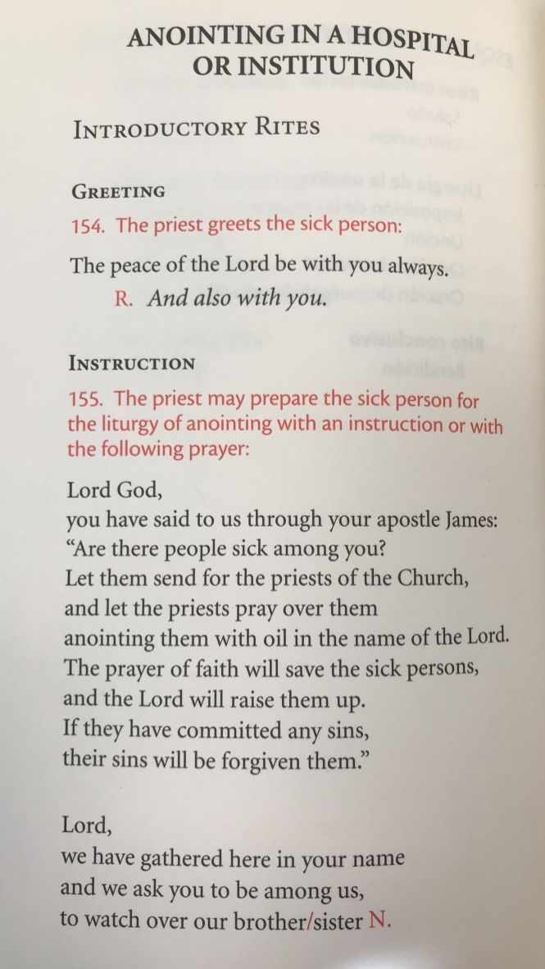
Let’s look at the practice of this Sacrament a little closer…

Slide 25
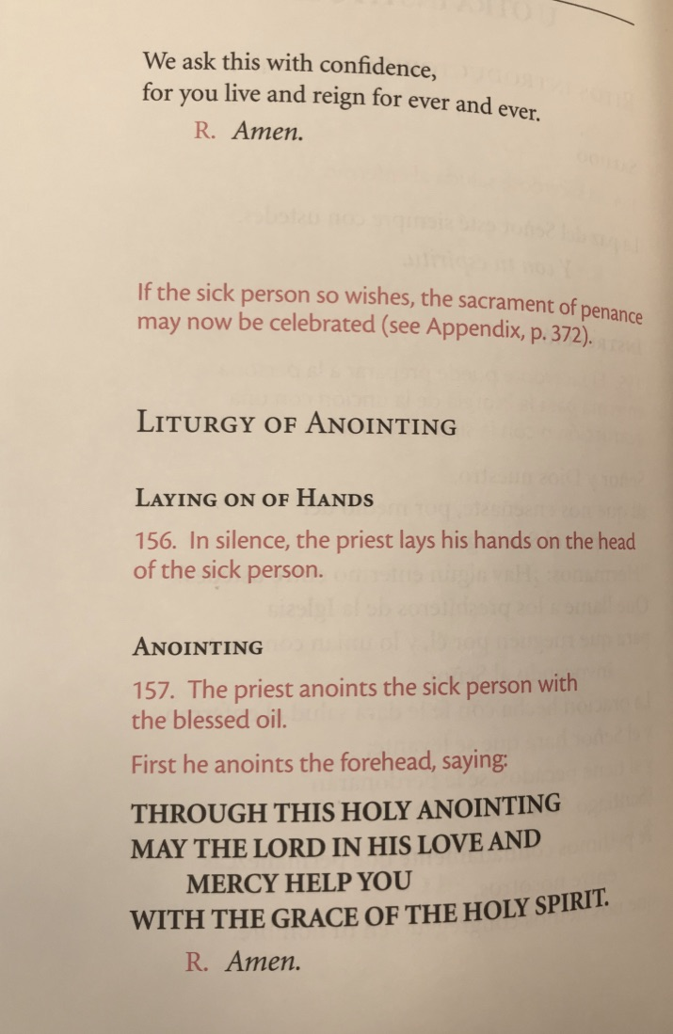

Slide 26
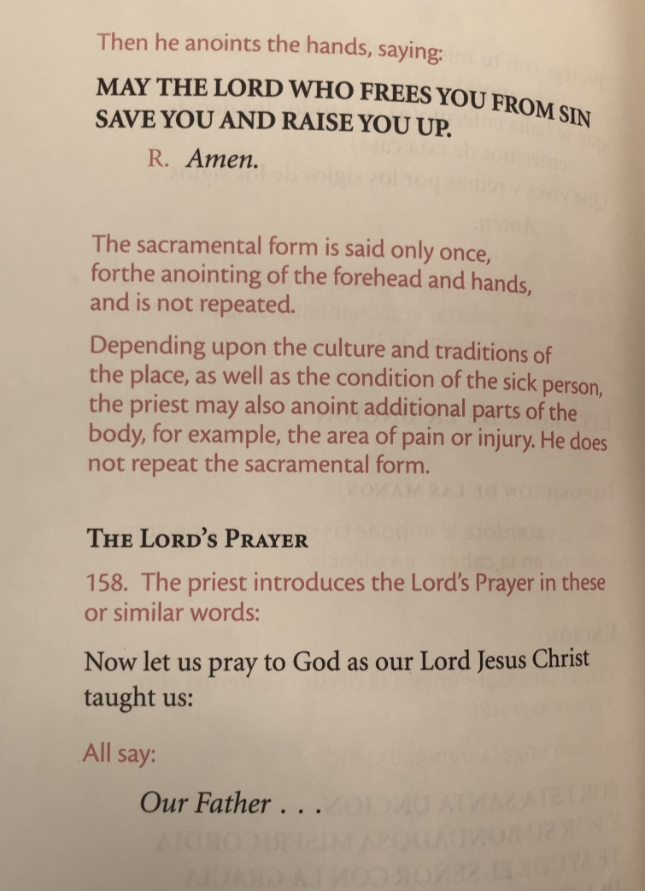

Slide 27
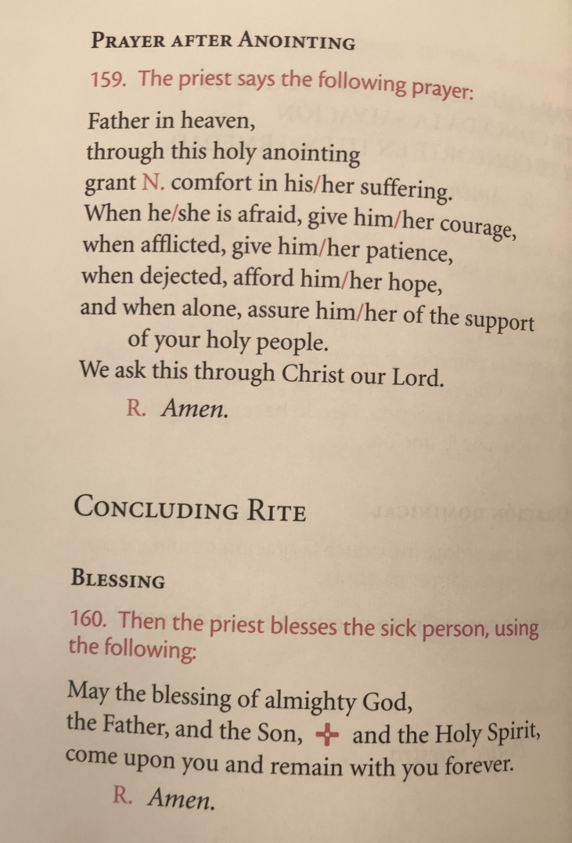

Slide 28
Final Thoughts or Questions?

